Slide 1

APEX INSTITUTE OF TECHNOLOGY
DEPARTMENT OF COMPUTER SCIENCE & ENGINEERING
Computer Organization & Architecture (21CSH-281)
Faculty: Siddharth Kumar (E12853)
Lecture - 12
Computer Arithmetic: Multiplication – Shift-and-add
DISCOVER . LEARN . EMPOWER

Slide 2
Computer Organization & Architecture: Course Objectives
COURSE OBJECTIVES
The course aims to:
The purpose of the course is to introduce principles of computer organization and the basic architectural concepts.
It begins with basic organization, design, and programming of a simple digital computer and introduces simple register transfer language to specify various computer operations.
Topics include computer arithmetic, instruction set design, microprogrammed control unit, pipelining and vector processing, memory organization and I/O systems, and multiprocessors.
To familiarize Students with the detailed Architectures of a Central Processing Unit.
Learn the different types of serial communication techniques.

Slide 3
COURSE OUTCOMES
On completion of this course, the students shall be able to:-
CO1 | Identify and interpret the basics of instruction sets and their impact on the design, organization, and functionality of various functional units of a computer comparable to the CPU, memory organization, I/O organization, and parallel processors.
CO2 | Analysis of the design of arithmetic & logic unit and understanding of the fixed point and floating-point arithmetic operations.
CO3 | Relate cost performance and design trade-offs in designing and constructing a computer processor which includes memory.
CO4 | Understanding the different ways of communicating with I/O devices and standard I/O interfaces.
CO5 | Implementation of control unit techniques and the concept of Pipelining.

Slide 4
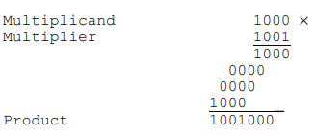
Multiplication- Shift and add
Shift-and-add multiplication is similar to the multiplication performed by paper and pencil. This method adds the multiplicand X to itself Y times, where Y denotes the multiplier. To multiply two numbers by paper and pencil, the algorithm is to take the digits of the multiplier one at a time from right to left, multiplying the multiplicand by a single digit of the multiplier and placing the intermediate product in the appropriate positions to the left of the earlier results.
As an example, consider the multiplication of two unsigned 4-bit numbers, 8 (1000) and 9 (1001).
In the case of binary multiplication, since the digits are 0 and 1, each step of the multiplication is simple. If the multiplier digit is 1, a copy of the multiplicand (1 ×multiplicand) is placed in the proper positions; if the multiplier digit is 0, a number of 0 digits (0 × multiplicand) are placed in the proper positions.

Slide 5
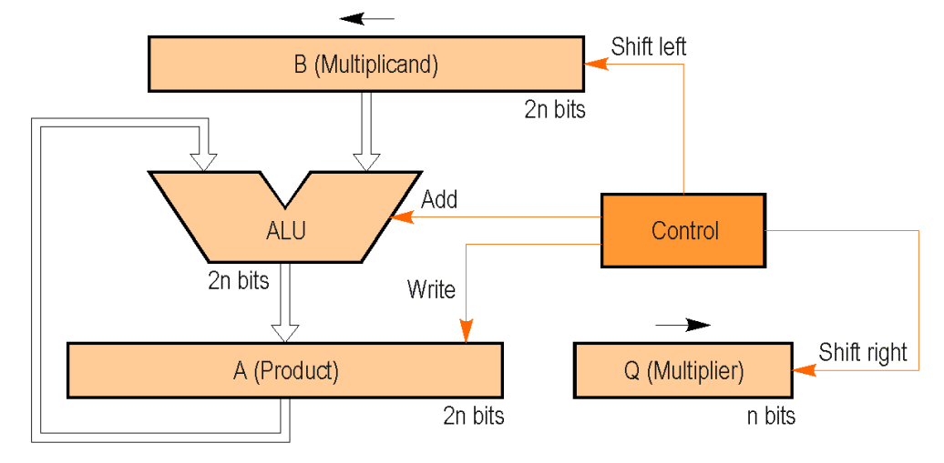
Consider the multiplication of positive numbers. The first version of the multiplier circuit, which implements the shift-and-add multiplication method for two n-bit numbers, is shown in Figure.
First version of the multiplier circuit

Slide 6
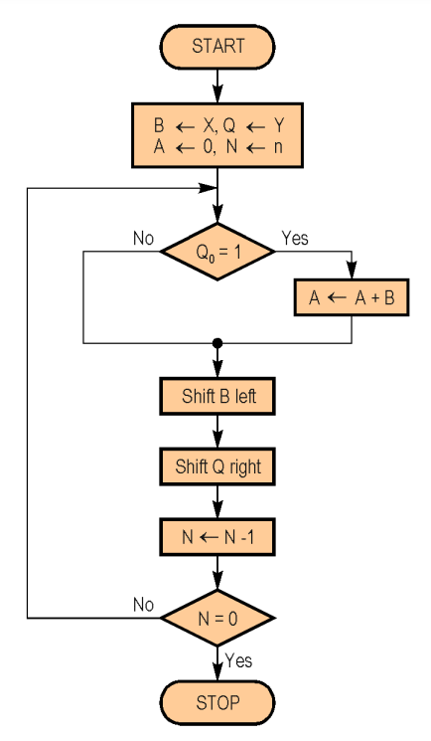
The 2n-bit product register (A) is initialized to 0. Since the basic algorithm shifts the multiplicand register (B) left one position each step to align the multiplicand with the sum being accumulated in the product register, we use a 2n-bit multiplicand register with the multiplicand placed in the right half of the register and with 0 in the left half. Figure shows the basic steps needed for the multiplication. The algorithm starts by loading the multiplicand into the B register, loading the multiplier into the Q register, and initializing the A register to 0. The counter N is initialized to n. The least significant bit of the multiplier register (Q0) determines whether the multiplicand is added to the product register. The left shift of the multiplicand has the effect of shifting the intermediate products to the left, just as when multiplying by paper and pencil. The right shift of the multiplier prepares the next bit of the multiplier to examine in the following iteration.

Slide 7
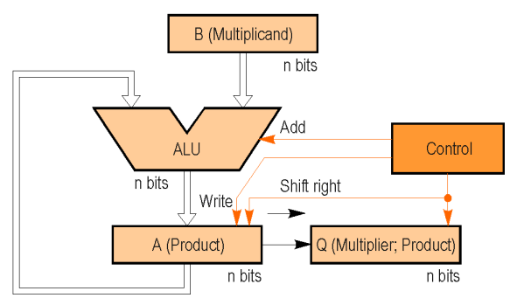
Another observation is that the product register has an empty space with the size equal to that of the multiplier. As the empty space in the product register disappears, so do the bits of the multiplier. In consequence, the final version of the multiplier circuit combines the product (A register) with the multiplier (Q register). The A register is only n bits wide, and the product is formed in the A and Q registers. Figure shows the new version of the circuit.
Final version of the multiplier circuit

Slide 8
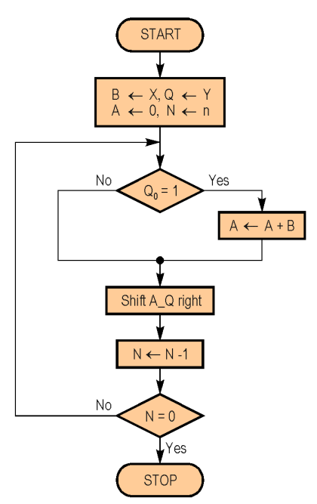

Slide 9
Summary
Discussed about Multiplication – shift-and-add.
Assessment Questions
Q1. How is Multiplication – shift-and-add performed?

Slide 10
THANK YOU

